Slide 1
Introduction to MATLAB/Simulink Application in Linear Control Systems
Fall 2024

Slide 2
Session 2

Slide 3
AGENDA
Solve Differential Equations
Laplace Transform
Transfer Function
Plot in MATLAB
State Space

Slide 4
Solve Differential Equations

Slide 5
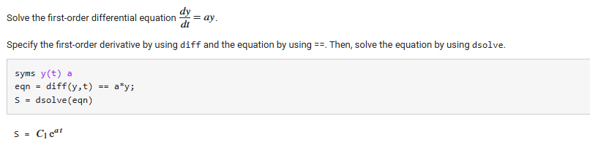
syms
dsolve()

Slide 6
Laplace Transform

Slide 7
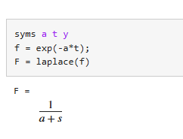
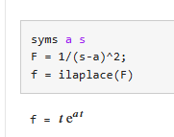
laplace() ilaplace()

Slide 8
Transfer Function

Slide 9
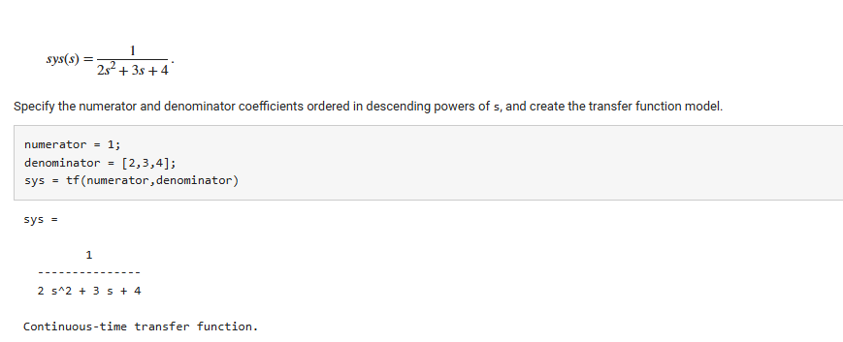
tf()

Slide 10
Plot in matlab

Slide 11
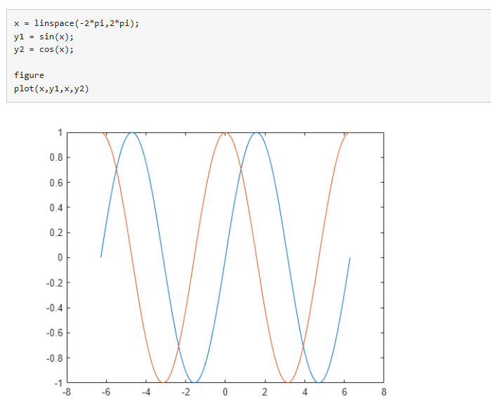

Slide 12
State Space

Slide 13
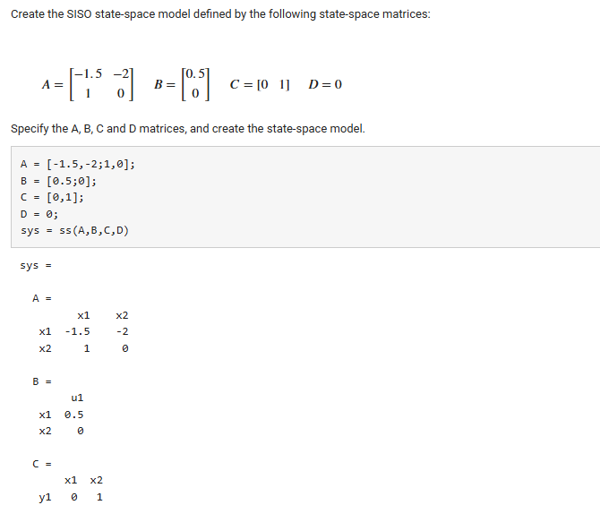

Slide 14
example

Slide 15
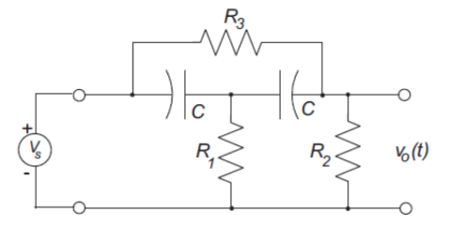
Bridged-T Filter

Slide 16
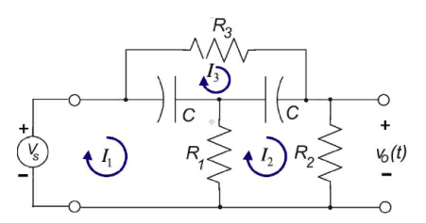
Bridged-T Filter

Slide 17
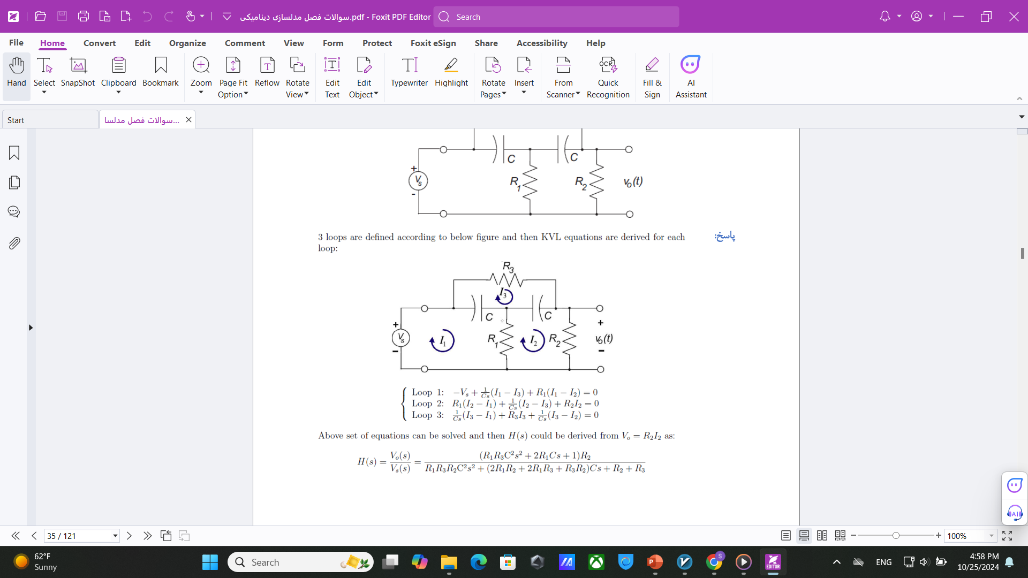
Bridged-T Filter

Slide 18
Bridged-T Filter

Slide 19
Bridged-T Filter

Slide 20
Bridged-T Filter

Slide 21
THANK YOU
GitHub: https://github.com/LinearControlSystems/MATLAB-Simulink-Applications

